Slide 1
Fiscal Year End Workshop 2019
Procurement Services, Budget and Finance & Accounting

Slide 2
AGENDA: Preparation for Year End Procurement and Disbursement Services Core Office Duties Budgets Payroll Treasury Management General Accounting New Year Reminders
Procurement Services and Finance & Accounting – Fiscal Year End Workshop

Slide 3
Preparing for Fiscal Year End Things to Do Now
Procurement Services and Finance & Accounting – Fiscal Year End Workshop
General Accounting Website http://www.fa.ufl.edu/departments/general-accounting/closing-and-year-end-schedules/
Checking available balances
Reviewing open encumbrance reports
Finalize any POs/TAs not needed
Amount Only POs

Slide 4
Important Dates
Procurement Services and Finance & Accounting – Fiscal Year End Workshop
Procurement 5/8/19 – Reqs above $75K 6/10/19 – Begin to enter FY20 Reqs 6/14/19 – Last day to input a Req against FY19 6/14/19 – Last day to input a Change Order against a FY19 PO
PCard 6/19/19 – Last day to approve a PCard charge for FY19

Slide 5
Important Dates
Procurement Services and Finance & Accounting – Fiscal Year End Workshop
AP/MPS 6/19/19 – Last day to approve invoices for FY19
Travel 6/10/19 – Travel will begin closing TAs where the end date is prior to 4/30/19 6/18/19 – Last day to enter Travel transactions for FY19 6/19/19 – Last day to approve Travel transactions for FY19

Slide 6
Core Offices Duties Why can’t we have access to the system?
Procurement Services and Finance & Accounting – Fiscal Year End Workshop
What is PO Roll and why?
What POs roll For assistance: procurement@ufl.edu disbursements@ufl.edu https://procurement.ufl.edu/

Slide 7
Example of a PO that has rolled
Procurement Services and Finance & Accounting – Fiscal Year End Workshop

Slide 8
Core Offices Duties Why can’t we have access to the system?
Procurement Services and Finance & Accounting – Fiscal Year End Workshop
What happens to the POs/TAs
What happens to the KK ledger?
UF_LEDGER_KK_APPROP_YEAREND
For assistance: procurement@ufl.edu disbursements@ufl.edu https://procurement.ufl.edu/

Slide 9
What happens to the KK ledger?
Procurement Services and Finance & Accounting – Fiscal Year End Workshop

Slide 10
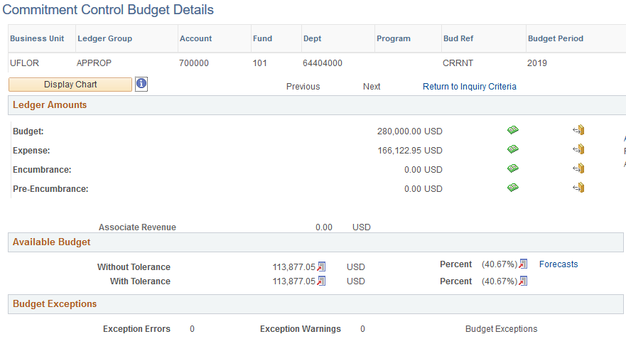
What happens to the KK ledger?
Procurement Services and Finance & Accounting – Fiscal Year End Workshop

Slide 11
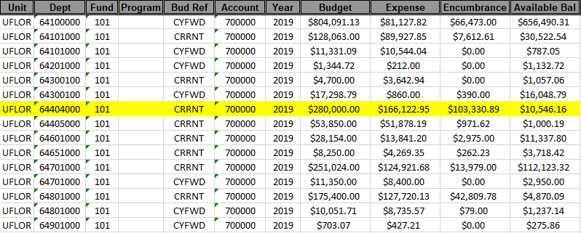
What happens to the KK ledger?
Procurement Services and Finance & Accounting – Fiscal Year End Workshop
UF_LEDGER_KK_APPROP_YEAREND

Slide 12
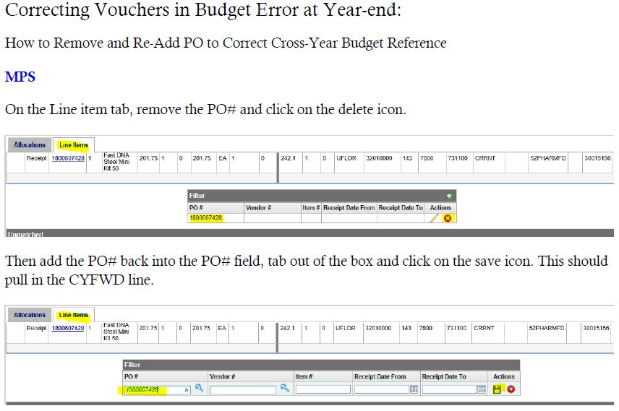
Core Offices Duties Why can’t we have access to the system?
Procurement Services and Finance & Accounting – Fiscal Year End Workshop
How to process invoices in MPS against a rolled PO
Toolkit on the HR website: Financials>myUF Payment Solutions

Slide 13
Core Offices Duties Why can’t we have access to the system?
Procurement Services and Finance & Accounting – Fiscal Year End Workshop
Tasks that can still be done during year end (PCard approval, non-APPROP POs)
Clean up of errors Vouchers POs
For assistance: procurement@ufl.edu disbursements@ufl.edu https://procurement.ufl.edu/

Slide 14
Budget - Important Dates
Procurement Services and Finance & Accounting – Fiscal Year End Workshop
Budget 5/13-6/14 – Depts enter info into the Budget system 6/21/19 – Last day to process Budget transfers 6/25/19 – FY20 CRRNT Budget will be entered 7/22/19 – Carryforward Budget Loaded

Slide 15
Budget
Procurement Services and Finance & Accounting – Fiscal Year End Workshop
Why are Budget Transfers Restricted During Year End?
Correct Negative Balances Prior to CYFWD Roll
CYFWD Budget Roll Process
Rolled POs/TAs
Remaining CRRNT
Remaining CYFWD
Hyperion Drives New Year Budget Load
Refresher Training
Open Labs

Slide 16
Payroll
Procurement Services and Finance & Accounting – Fiscal Year End Workshop
We do it all for the employee
Pay is Personal
Cash is King
New Hires (We were all new once)
Get Paid!!
Distributions
How funds are allocated
Everyone has to go somewhere

Slide 17
Payroll - Important Dates
Procurement Services and Finance & Accounting – Fiscal Year End Workshop
6/20/19 – Last day to change distributions for FY19
Pay period end 6/27/19
Pay period end 7/11/19 (includes 6/28/19 – 6/30/19)
6/21/19 – Fiscal year end system rollover occurs
FY20 department budget table (DBT) is available
Departments must activate all rollover DBTS by noon 7/12/19
6/21/19-6/27/19 – Any new FY19 DBTs (new hires) must be submitted using the Payroll Distribution Retro Request Form
7/3/19 – Cross college processors can access FY18 & FY19
7/12/19 – Noon – new hires DBY for FY19 & FY20 must be created
7/15/19 – All inactive DBTs – they gone

Slide 18
Treasury Management - Important Dates
Procurement Services and Finance & Accounting – Fiscal Year End Workshop
6/27/19 – Cash Expense Refunds for FY19 must be received by University Cashiers/Treasury Management
6/28/19 – Cash and Check Deposits for FY19 must be received by University Cashiers/
Treasury Management
7/2/19 – Last day to Credit Card, EFT/ACH,
and Wires deposits
7/2/19 – Last day to enter deposit
correction journals

Slide 19
General Accounting - Important Dates
Procurement Services and Finance & Accounting – Fiscal Year End Workshop
5/31/19 – Last day to request new DeptID, flex, and Source of Fund for use in FY19.
6/13/19 – Last day to request new payroll
combination codes
for use in FY19. 6/21/19 – Last day to create GL journal
entries for appropriation
funds.
7/3/19 – Last day to create GL journal
entries for non appropriation
funds.

Slide 20
General Accounting - Journals
Procurement Services and Finance & Accounting – Fiscal Year End Workshop
Earlier 6/21 deadline for journals with appropriation funds
Funds 101-109, 192, and 221 & 222
Applies to all journal sources
After 6/21, budget will be close for FY19: “Budget is Closed” error.
All journals with “Budget is Closed” errors will need to be deleted.
7/3 deadline to create journals for all other funds

Slide 21
New Year Reminders
Procurement Services and Finance & Accounting – Fiscal Year End Workshop
Date for access to the system – 7/3/19
Reminder about processing invoices against rolled POs
Reminder about recurring vouchers
Reminder about processing POs during year end

Slide 22
Happy Fiscal New Year!!

Slide 23
Questions?
Procurement Services and Finance & Accounting
Fiscal Year End Workshop 2019

