Slide 1

Cost Comparisons
March 14, 2024

Slide 2

Agenda
UF Directives on Cost Comparisons
Required Documentation
Established Exceptions & the Exception Process
How to Create a Cost Comparison
Demo
Questions
UF GO Cost Comparisons

Slide 3
Cost Comparison ~ UF Directives
Any trip that includes costs for upgrades, convenience, and/or personal travel will require a cost comparison to ensure that the University is not paying for costs unrelated to or unallowable on official UF business.
Click here to access the Travel Directives
UF GO Cost Comparisons

Slide 4
Cost Comparison ~ UF Directives
This includes:
personal extended stay at the business location,
personal deviations to a non-business location in conjunction with official business travel, as well as,
non-reimbursable travel upgrades
University Travelers or their Delegates should obtain a cost comparison through UF GO’s online booking tool or the University’s authorized travel agent (WTS) at time of booking to validate the reimbursable portion of the business-only equivalency of the fare.
This cost comparison is to be included as supporting documentation on the Travel Expense Report when personal travel and/or upgrades are included.
UF GO Cost Comparisons
Notes:
Talk about business and personal travel here.
Talk about difference between business and personal.

Slide 5
Cost Comparison ~ UF Directives
Cost comparison supporting documentation should:
Represent the cost of the most direct route to and from the business location for the days of business travel only (i.e., reflect the business trip as though no personal travel is included)
Select the least expensive airfare within the main cabin class (e.g., economy, coach)
Not be limited to results from a particular carrier or number of stops
Note: If an airline automatically grants an air class upgrade based on traveler status and there is no cost to the University, the Traveler should still provide a cost comparison and attach it to the Expense Report.
UF GO Cost Comparisons

Slide 6
Read me later
Cost Comparison ~ UF Directives
Established Exceptions
At times, it may be impractical to use the booking tools offered by the University due to system limitations.
Alternate booking outside of UF GO or with the University’s authorized travel agency may be permissible for reimbursement for documented instances, including when:
A hotel offers a discount code to be used with a conference block where a hotel website must be used to enter the code directly
Rental properties (Airbnb, Vrbo, campgrounds, etc.) that cannot be found in the booking tool result in lowest cost to the University and include a cost comparison
Air travel to an international location where Authorized Travel Agent cannot provide support or a supplier does not accept a University PCard or other UF forms of payment (ex. Airfare in a remote international location)
A University Traveler uses miles/points to upgrade the airfare from coach/lowest cost to their preferred airfare class and this results in a less expensive airfare ticket than the amount the University would have paid for coach/lowest cost
If a guest (non-profiled traveler) is booking their business travel, they are not required to use the booking tool
Violation of this directive may result in delay or denial of expense reimbursement, loss of approver/delegate responsibility, restitution for personal/unallowable PCard charges, and/or disciplinary action, up to and including termination of employment.
UF GO Cost Comparisons

Slide 7

Let’s Simplify this!

Slide 8
Why a cost comparison Required
Two main reasons cost comparisons are required:
    1. Personal travel is included on a business trip
    Requests to book outside of the booking tool/World Travel Service (WTS)
Cost Comparisons are required when requesting to book airfare, hotels, or rental cars outside of the Concur Booking Tool, either due to a 20% cost differential or for any other reason.
UF GO Cost Comparisons

Slide 9
What is a cost comparison
Personal Travel | Exception to Booking Tool
Comparison Between: | Comparison Between:
The least expensive direct flight which shows prices for only the business travel dates. Created using the UF GO Booking Tool or by calling WTS | The least expensive direct flight created using the UF GO Booking Tool or by calling WTS
VS. | VS.
The flight that was actually booked for your trip, which includes personal travel days (i.e., several days before and/or after the business portion of the trip). | The flight that you are requesting to book which was found outside of the UF GO booking tool (i.e. directly with the airline).
The Traveler’s reimbursement will be equal to the lesser of the two options.
UF GO Cost Comparisons

Slide 10
When to complete a cost comparison
Cost comparisons are most accurate when completed at the same time the trip is booked.
When a cost comparison is not completed at the time of booking, or it doesn’t provide all the required information, the cost comparison will have to be created after the fact.
It is often less accurate at this point since prices fluctuate.
Not completing the cost comparison timely could result in the traveler not receiving their full reimbursement.
UF GO Cost Comparisons

Slide 11
Established Exceptions
Exception Reasons | Exception Form Required? | Cost Comparison Required? | Financial Accountable Officer Approval Required?
Conference Hotel Discounted Rate | No | No | No
Airbnb, VRBO, Campgrounds and other rental properties not found in the booking tool | No | Yes | No
Air travel to a remote international location & WTS is not able to book | No | No | No
Traveler uses personal miles/ points for upgrade | No | Yes | No
Guests who prefer to book their own trip | No | No | No
* Any time an established exception is used, make sure to comment on the expense report explaining the reason why the booking tool was not used.
UF GO Cost Comparisons

Slide 12
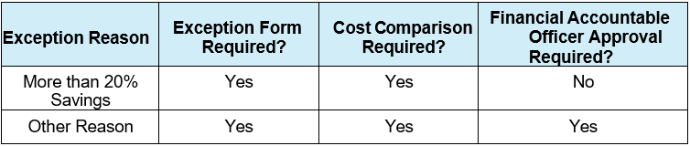
Booking Tool Exception Process
Additional Exceptions
Every effort should be made to use the University booking tool. In cases not covered by the exceptions listed above, follow the procedures outlined in the UF GO Booking Tool Exception Process document.
UF GO Booking Tool Exception Process
Booking Tool Exception Form
UF GO Cost Comparisons
Notes:
Mention who the FAO is and where to find it.

Slide 13
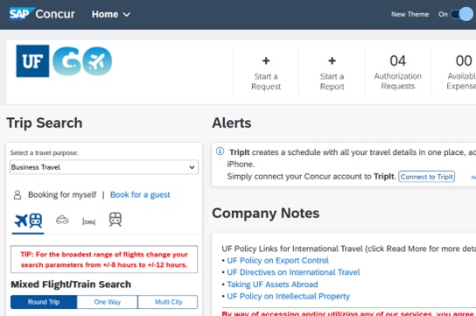
How to complete a cost comparison
Steps
Log into UF GO
In the Depart and Return fields, select the dates you would have travelled if personal travel was not included.
UF GO Cost Comparisons
Notes:
Example is for personal travel.

Slide 14
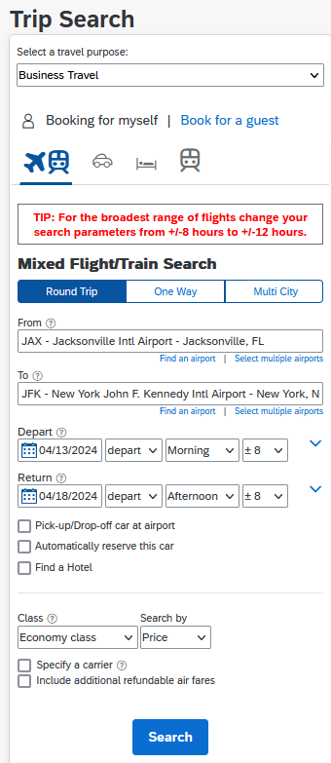
How to complete a cost comparison
Steps
Search for a direct flight to your business location using these search terms:
Select a travel purpose: Business Travel
Class: Economy class
Search by: Price
Your search should include all airlines
Click Search
UF GO Cost Comparisons
Notes:
Economy class (this is the best search option, it will show you all available fares above Economy)
Do not search by a specific carrier.
Once the search results populate, review the options. Since you’ve searched by price, the least expensive flights will populate first.

Slide 15
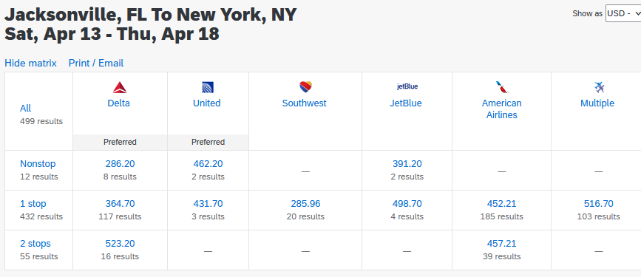
How to complete a cost comparison
When there are multiple airline choices, make sure to click on “Show matrix” to see all your options.
UF GO Cost Comparisons

Slide 16
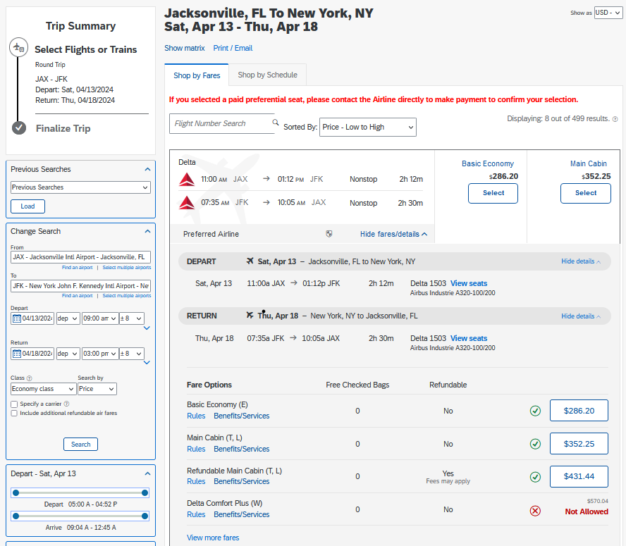
How to complete a cost comparison
Click on “More fares/details” to see all available seat options on a particular flight.
If you don’t show all the available fares, your cost comparison will not be accurate.
UF GO Cost Comparisons
Notes:
Make sure to talk about the checked bag and refundable trips.

Slide 17

How to complete a cost comparison
Documenting the cost comparison accurately is VERY important.
Include these items are on your documentation:
Date the cost comparison was obtained
Dates of business travel, including the allowable travel days before and after the trip
To and From location
Airfare Class of each leg of the flight
Times of departure/arrival (these should be reasonable, i.e. don’t compare a flight that leaves in the late evening to one that leaves in the morning).
Total cost of the flight(s)
UF GO Cost Comparisons

Slide 18
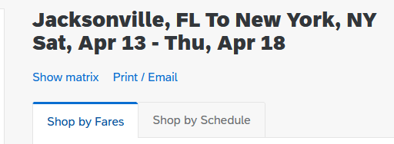
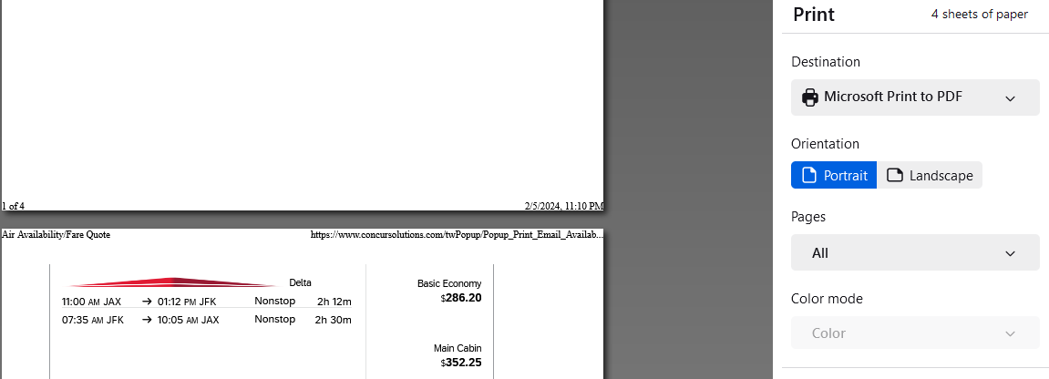
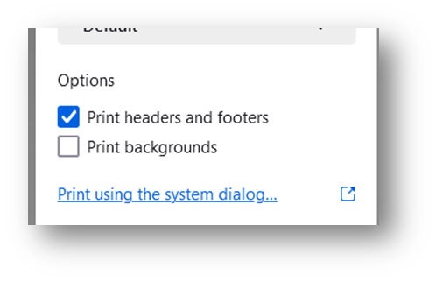
How to complete a cost comparison
Printing the Cost Comparison
Click the Print / Email button
Click Print Flights or Email Flights
Once the Print dialog screen pops up:
  For the printer destination, choose Microsoft Print to PDF.
  Ensure that the date is displayed on the PDF. To do this go to your print options and check the box Print headers and footers.
  Save the PDF and attach it to your Expense Report.
UF GO Cost Comparisons
Notes:
(Tip: Print Flight is formatted better than Email flight)

Slide 19

How to complete a cost comparison
World Travel Services (WTS) is the University of Florida’s Travel Management Company and authorized travel agent.
Cost Comparisons can also be completed by calling or emailing WTS. Ask the agent to email you the airfare, hotel, or rental car quote that best meets policy.
ufl.travel@worldtrav.com
865-288-1901 (After hours code: S-5CWK)
UF GO Cost Comparisons

Slide 20

Other Cost-related considerations
Checked Baggage – Do both comparisons include a checked bag or just a carryon?
Refundability – Are both comparisons refundable?
Airfare Discounts – UF receives discounts from some airlines. This discount is not applied until just before the system issues the ticket.
UF GO Cost Comparisons
Notes:
Compare Apples to apples.

Slide 21
Demo

Slide 22
Questions?

Slide 23
Contact Form: PCard and Travel Support
We are happy to help!
CONTACT US!
UF Travel Department: 352-392-1241
UF PCard Team: 352-392-1331

