Slide 1
Processing Personal Expenses
May 21, 2024

Slide 2
Agenda
Housekeeping
What is a Personal Expense
Expense Type vs Payment Type
PCard
Travel
Demo
Questions
UF GO Processing Personal Expenses

Slide 3
Housekeeping
Slides
Recording
Instruction Guides
Questions
UF GO Processing Personal Expenses

Slide 4
What is a personal Expense?
Expenses of a personal nature charged to the PCard or Air Card
Made by accident or due to ignorance of policy/directives
Have no valid business purpose
Must be reimbursed to the university
UF GO Processing Personal Expenses

Slide 5
Expense Type vs Payment Type
Personal Expense | Personal Funds
Expense of a personal nature Payment Type is either: UFLOR PCard UFLOR Air Card Processed using Expense Type: Personal Expense | Payment Type Denotes an expense made with personal payment method, e.g., cash, personal credit card Processed using the Expense Type that best describes the transaction
UF GO Processing Personal Expenses

Slide 6
Personal Expense TIP:
Payment Type | Expense Type
Personal Funds | Personal Expense
If the Payment Type is Personal Funds, the
Expense Type cannot be Personal Expense
Instead: Reduce the amount of the Personal Funds
X
UF GO Processing Personal Expenses
Notes:
The amount of the Personal Funds should be reduced to the exact amount that the traveler will be reimbursed. Include comments as to why this amount is less than the receipt.

Slide 7
personal Expense – Travel vs PCard
Personal Expenses are handled differently based on the type of transaction
Travel related expense(s)
Travel Report
Non-travel expense(s)
PCard Only Expense Report
UF GO Processing Personal Expenses
Notes:
Travel related > Travel Report
Non-travel related > PCard Only Expense Report
So even though the processes are quite similar for both scenarios, we will review them separately to avoid confusion.

Slide 8
Processing Personal Expenses: PCard Only (Non-Travel) Report

Slide 9
Personal Expenses on A Pcard (Non-Travel)
All PCard purchases should comply with the guidelines on Allowable, Conditonal, and Non-Allowable Purchases
PCards should not be used for personal or non-allowable purchases
Personal use is grounds for a suspension or loss of PCard privileges
….but it happens
UF GO Processing Personal Expenses

Slide 10
Personal Expenses on A Pcard (Non-Travel)
Notify the PCard Team
Deposit/Refund to the university
Process charge(s) in
UF GO
Step 1
Step 2
Step 3
UF GO Processing Personal Expenses

Slide 11
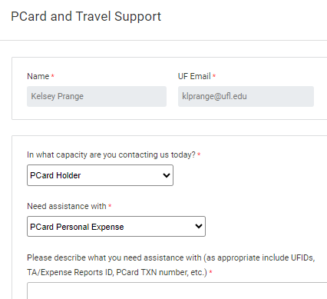
Personal Expenses on A Pcard (Non-Travel)
Step 1: Notify the PCard Team Immediately
Facilitates timely processing and maintains transparency
Use the PCard & Travel Support Contact Form
Needs assistance with: PCard Personal Expense
UF GO Processing Personal Expenses

Slide 12
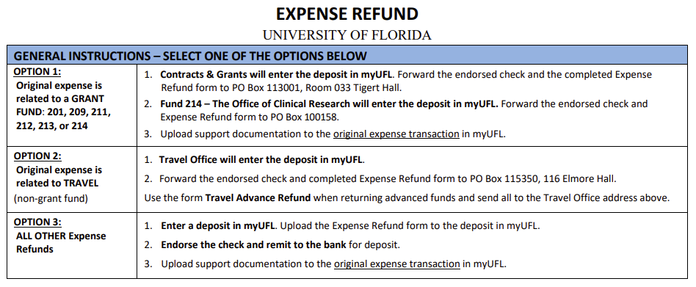
Personal Expenses on A Pcard (Non-Travel)
Step 2: Deposit/Refund to the university
Write a check to "University of Florida" within 5 days
Fill out an Expense Refund Form* (see Expense Refunds, Revenue Refunds, and Credit Memos)
Record the deposit in myUFL* (see Processing an Expense Refund)
*must process in UF GO to obtain Journal ID needed for forms
UF GO Processing Personal Expenses

Slide 13
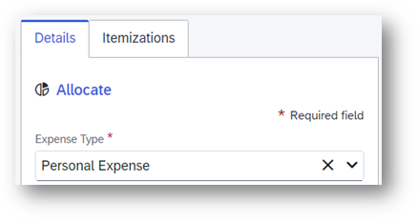
Personal Expenses on A Pcard (Non-Travel)
Step 3: Process in UF GO
Add the transaction to a PCard Only (Non-Travel) Expense Report
Enter "Personal Expense" in the Expense Type drop down menu
If needed, itemize the personal portion
UF GO Processing Personal Expenses

Slide 14
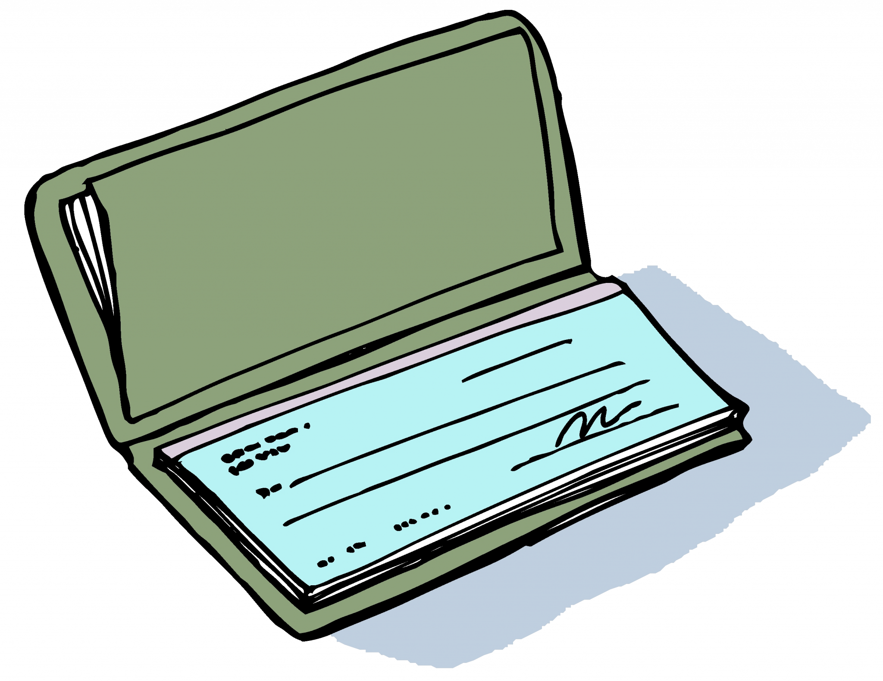
Personal Expenses on A Pcard (Non-Travel)
Step 3: Process in UF GO
3. Attach a copy of the refund check (redact account/routing #s)
4. Submit the report
5. Once deposit is complete, attach
copies of the Expense Refund Form
and the deposit
UF GO Processing Personal Expenses

Slide 15
Personal Expenses on A Pcard (Non-Travel)
Step 4: Locate Transaction Information in myUFL - Journal ID
A transaction processed as a "Personal Expense" in UF GO will be recorded as a Journal Entry in myUFL
It will not create a voucher
Journal ID is required for the Expense Refund Form and deposit
After the PCard Only (Non-Travel) Expense Report is fully approved in UF GO, obtain the Journal ID with a query in myUFL
UF GO Processing Personal Expenses

Slide 16
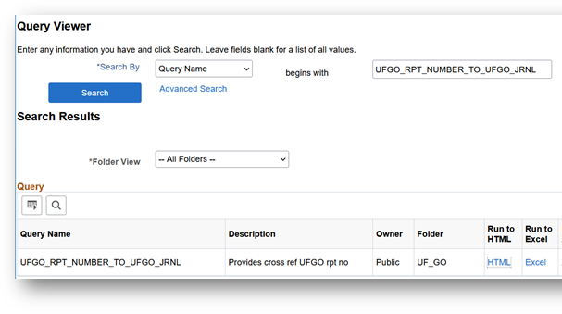
Personal Expenses on A Pcard (Non-Travel)
Step 4: Locate Journal ID
Navigate to Query Viewer in myUFL
Main Menu > Financials > Reporting Tools > Query > Query Viewer
Search for query UFGO_RPT_NUMBER_TO_UFGO_JRNL
UF GO Processing Personal Expenses

Slide 17
Personal Expenses on A Pcard (Non-Travel)
Step 4: Locate Journal ID
3. Enter the Report Number and click View Results
UF GO Processing Personal Expenses

Slide 18
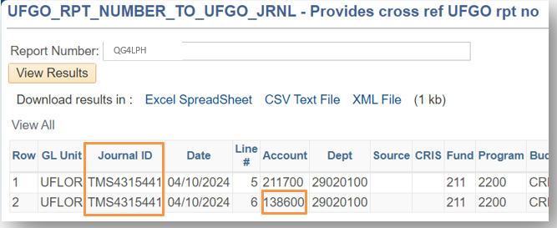
Personal Expenses on A Pcard (Non-Travel)
Step 4: Locate Journal ID
4. The Journal ID is in the Journal ID column (starts with TMS)
Chartfield should also be used for the deposit, including account code – 138600
UF GO Processing Personal Expenses

Slide 19
Personal Expenses on A Pcard (Non-Travel)
Step 4: Locate Journal ID
5. Use this Journal ID in the corresponding reference fields
Expense Refund Form
Field: Original Voucher, Expense Report No., or Journal ID (including line number)
Deposit
Field: Journal Reference Information
UF GO Processing Personal Expenses

Slide 20
Processing Personal Expenses: Travel Report

Slide 21
Personal Expenses on a Travel Report
Examples of Travel Related PCard charges
Hotel incidentals
e.g., room service, laundry, movies, etc.
Accidental PCard purchases
e.g., Uber charge for a personal excursion
Any expense that is not allowable per Travel Directives or PCard guidelines on Allowable, Conditional, and Non-Allowable Purchases
e.g., meals
UF GO Processing Personal Expenses

Slide 22
Personal Expenses on a Travel Report
Example of a personal Air Card transaction
The Air Card should not be used for personal flights
…but in certain situations, Air Card transactions can be partially personal
e. g. personal travel was included on a business trip; the cost comparison indicates that the business only portion of the flight would have been less expensive.
The difference is then itemized as a Personal Expense.
UF GO Processing Personal Expenses

Slide 23
Personal Expenses on a Travel Report
There are two methods for processing personal transactions in UF GO
When the transaction is entirely personal
OR
When the transaction is partially personal
UF GO Processing Personal Expenses

Slide 24
Personal Expenses on A Travel Report
The transaction is entirely personal:
Add the transaction to a Travel Report
Enter Personal Expense in the Expense Type drop down menu
UF GO Processing Personal Expenses

Slide 25
Personal Expenses on A Travel Report
TIP! Entirely personal PCard transactions can be added to PCard Only Reports
Purpose: to process the transaction before the trip is over.
Follow the PCard report process and add to a
PCard Only (Non-Travel) report
UF GO Processing Personal Expenses

Slide 26
Personal Expenses on Travel report
A portion of the transaction is personal:
Add the transaction to a Travel Report
Enter the Expense Type that best represents the charge
UF GO Processing Personal Expenses

Slide 27
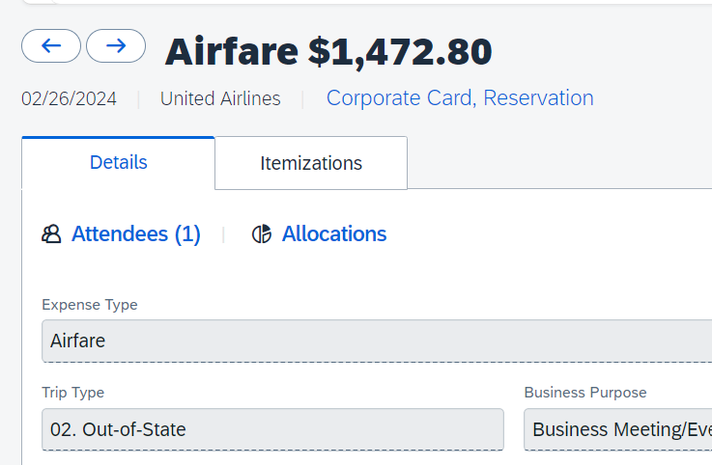
Personal Expenses on A Travel Report
A portion of the transaction is personal:
Itemize the transaction
Enter the business portion of the expense with the corresponding Expense Type
Enter the personal portion of the transaction using Expense Type Personal Expense
UF GO Processing Personal Expenses

Slide 28
Personal Expenses on a Travel Report
Currently, UF GO does not deduct the Personal Expense from the Personal Funds owed to the user.
The user must write a check to UF for the Personal Expenses incurred
We are working to reconfigure this process so Personal Expenses will be deducted from the amount due the user.
UF GO Processing Personal Expenses
Notes:
Mention that we will be going back and emailing them about the personal expenses that have been processed already

Slide 29
Personal Expenses on A Travel Report
Repayment Process
Process a Travel Report in UF GO
Write a check to the “University of Florida”
Once the report is processed, navigate to Query Viewer in myUFL
Main Menu > Financials > Reporting Tools > Query > Query Viewer
Search for query: UFGO_RPT_NUMBER_TO_UFGO_JRNL
Complete an Expense Refund Form using the results from the query:
Journal ID (Starts with TMS)
Account code for Personal Expenses: 138600
Chartfield
UF GO Processing Personal Expenses

Slide 30
Personal Expenses on A Travel Report
Repayment Process
Attach the Expense Refund Form and a copy of the check (with account info redacted) to the Travel Report
Send the Expense Refund Form and the Check to the Travel Department for Deposit
(see Expense Refunds, Revenue Refunds, and Credit Memos)
UF GO Processing Personal Expenses

Slide 31
Demo

Slide 32
Questions?

Slide 33
Contact Form: PCard and Travel Support We are happy to help!
CONTACT US!
UF Travel Department: 352-294-1114
UF PCard Team: 352-392-1331

